Slide 1

Jupyter Notebooks, PowerShell and Excel Automation
Rob Sewell
robsewell.com
@sqldbawithbeard

Slide 2
The Quick Version
We are dedicated to a harassment-free experience for everyone, regardless of who you are and what makes you you. We recognize the right of any individual to attend and participate. Anyone. This is included but not limited to gender identity and expression, sexual orientation, disability, physical appearance, body size, race, religion, or any other classification, affiliation, or label.
We do not tolerate harassment in any form. For the duration of your engagement with GroupBy and its programs, you are expected to act appropriately and to adhere to this Code of Conduct. This includes conduct in-person and online, at the conference itself, as well as any non-conference programs that may include participants: including talks, workshops, parties, on social media, and other online forums. GroupBy participants violating these rules may be sanctioned or expelled without a refund (if that applies) at the discretion of the conference organizers.
You can review the full policy at: GroupBy.org/Code-of-Conduct
Notes:
You do not need to read this full policy, just give people time to read this and explain they can review the full policy at the provided link.

Slide 3

Rob Sewell
Bearded Consultant
Automator
Trainer
Dual MVP
He/Him
Consultant Sewells Consulting Ltd
dbatoolsMoL dbachecks
ADSNotebooks PowerShell Community
Data Community
beard.media\book
@sqldbawithbeard
blog.robsewell.com

Slide 4
Rob Sewell
Bearded Consultant
Automator
Trainer
Dual MVP
Consultant Sewells Consulting Ltd
dbatoolsMoL dbachecks
ADSNotebooks PowerShell Community
Data Community
beard.media\book
@sqldbawithbeard
blog.robsewell.com
Notes:
OBS:SpeakerCircle

Slide 5
Rob Sewell
Bearded Consultant
Automator
Trainer
Dual MVP
Consultant Sewells Consulting Ltd
dbatoolsMoL dbachecks
ADSNotebooks PowerShell Community
Data Community
beard.media\book
@sqldbawithbeard
blog.robsewell.com
Notes:
OBS:SpeakerCircleandSide

Slide 6
Ask me questions anytime
Slides are always here - https://beard.media/presentations Notebooks are here - https://beard.media/Notebooks @SQLDbaWithBeard – Is where to find me later blog.robsewell.com – Is where to read things!
Notes:
OBS:Full Screen

Slide 7
Pop Quiz
In organisations – where is most data used ?
Notes:
OBS:Full Screen

Slide 8

Notes:
OBS:Full Screen

Slide 9
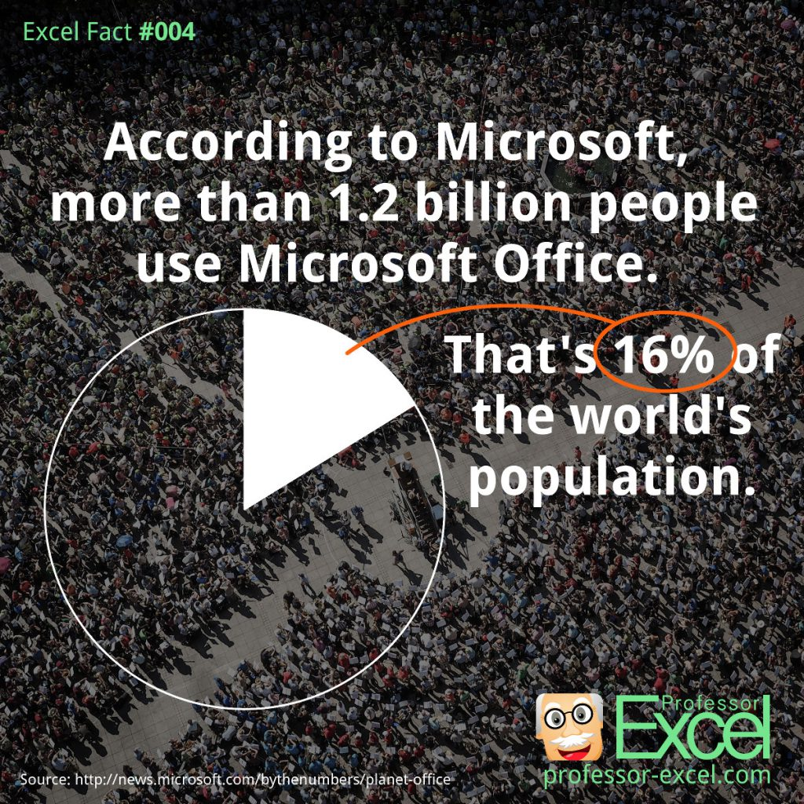
Notes:
OBS:SpeakerRightHalf

Slide 10


Notes:
OBS:SpeakerCentreBottom

Slide 11
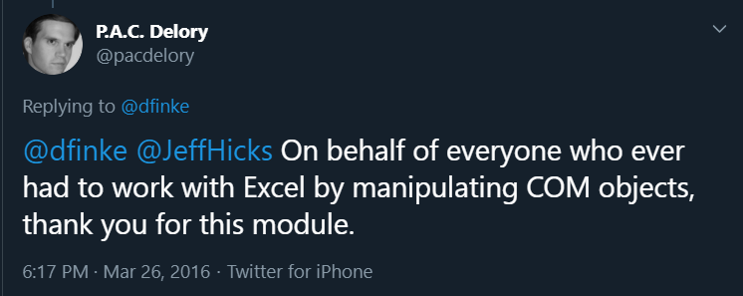
Notes:
OBS:SpeakerCentreBottom

Slide 12

Notes:
OBS:Full Screen

Slide 13

So – What IS a Jupyter Notebook?
Originally for Data Scientists
Notes:
OBS:SpeakerTinySquare

Slide 14

First – Lets go back in time

Slide 15
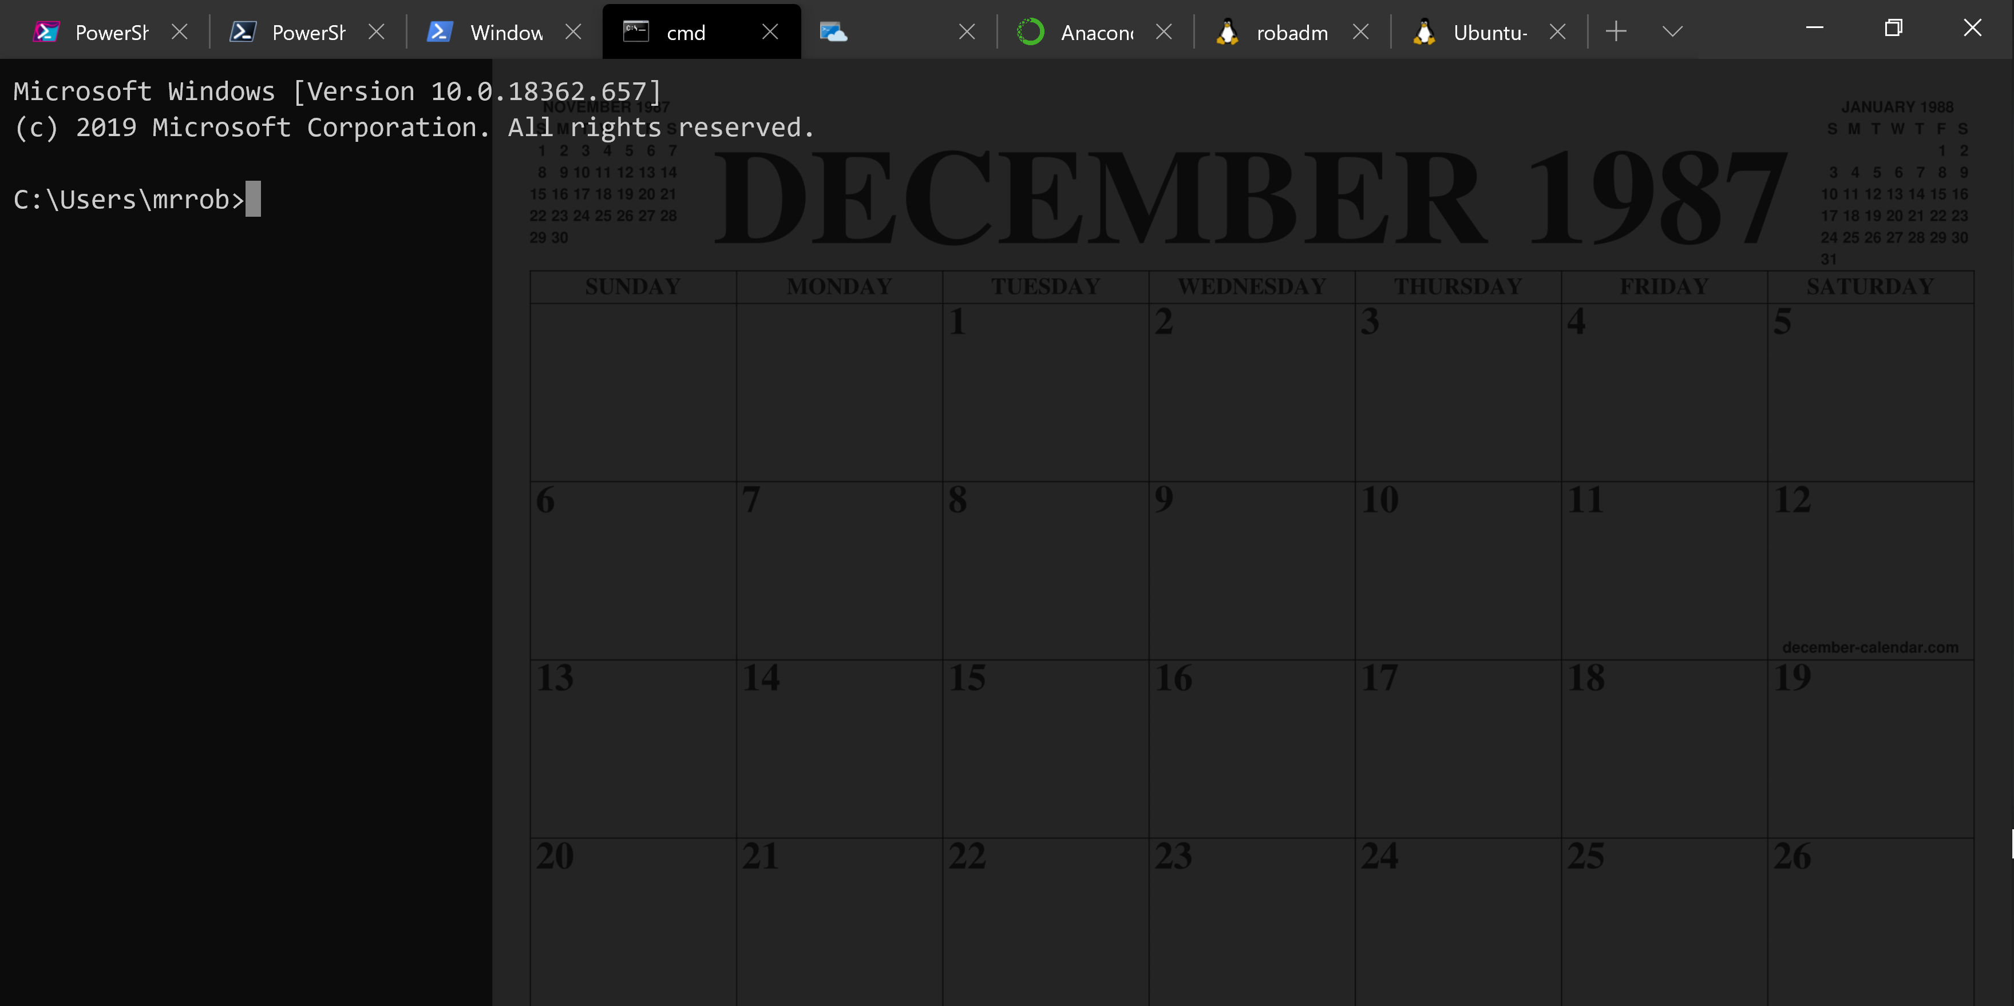
A Decade and a Half

Slide 16
Uh, Houston, we've had a problem
https://en.wikipedia.org/wiki/Houston,_we_have_a_problem

Slide 17

Running Queries

Slide 18
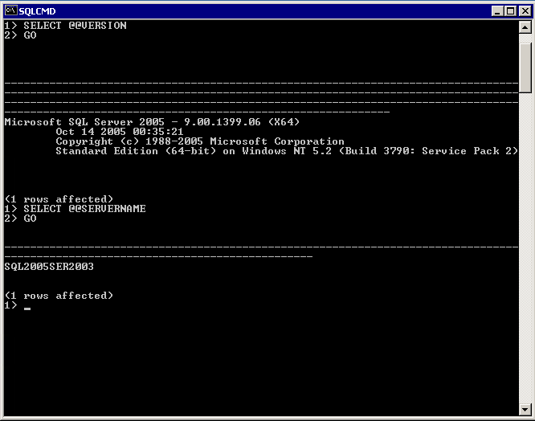
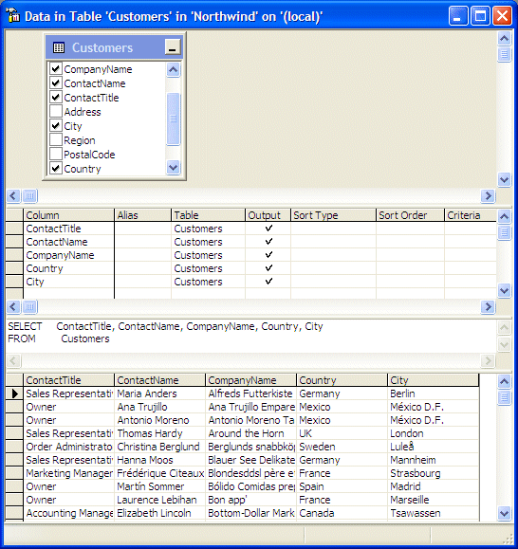

Slide 19
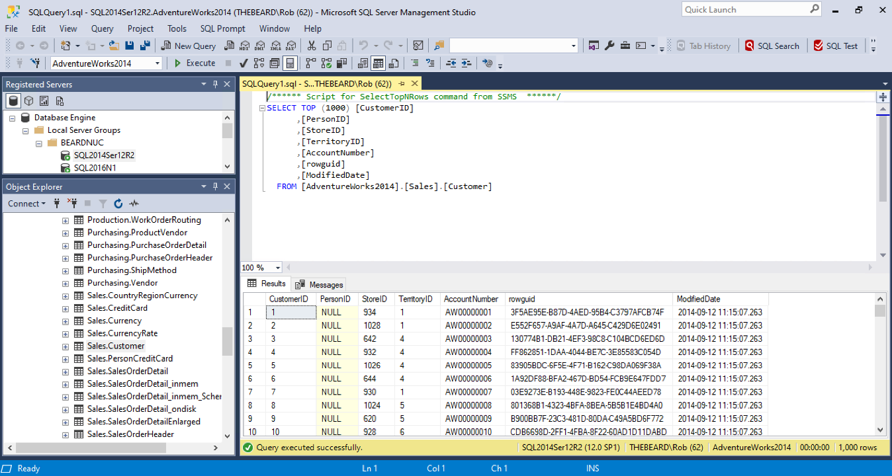

Slide 20
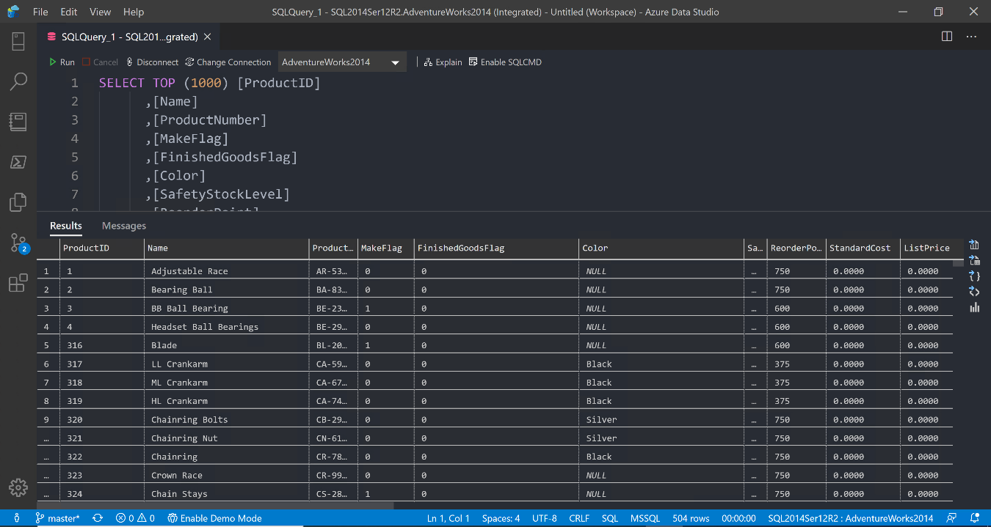

Slide 21
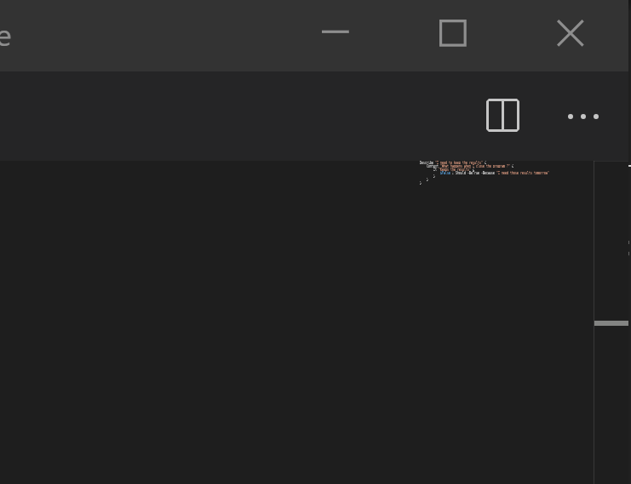
Notes:
OBS:SpeakerTopRight

Slide 22


Slide 23
ALL
GONE

Slide 24
What is a Jupyter Notebook?
Document that can contain text, code, images and query results
Notes:
OBS:SpeakerCentreBottom

Slide 25
What is a Jupyter Notebook?
Document that can contain text, code, images and query results
Notes:
OBS:SpeakerCentreBottom

Slide 26
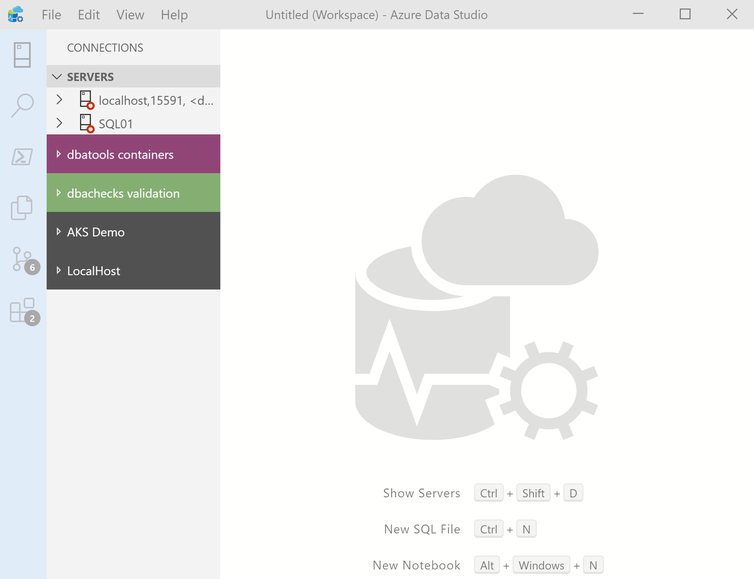
What’s Azure Data Studio ?
Cross Platform desktop environment for Data Professionals
Notes:
OBS:SpeakerCentreBottom

Slide 27
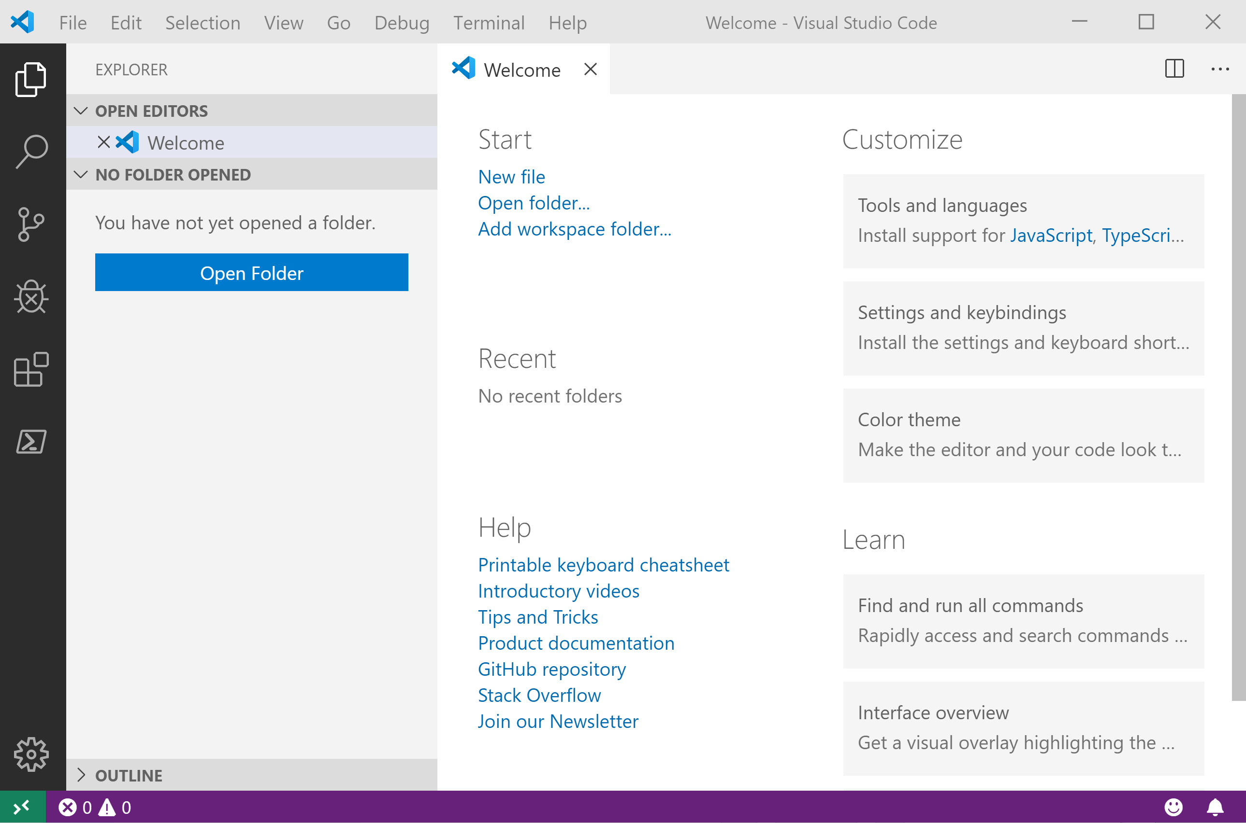
It Looks Like Visual Studio Code ?
Notes:
OBS:SpeakerCentreSquare

Slide 28
It Looks Like Visual Studio Code ?
Notes:
OBS:SpeakerCentreBottom

Slide 29
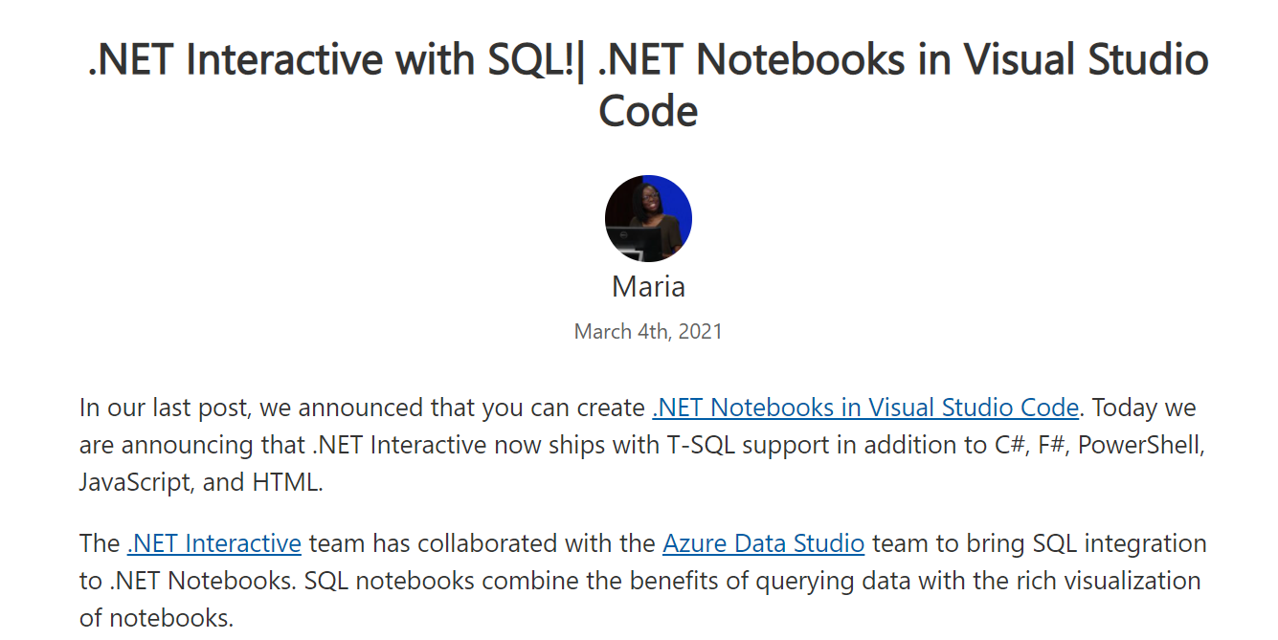
.NET Interactive Notebooks
https://devblogs.microsoft.com/dotnet/net-interactive-with-sql-net-notebooks-in-visual-studio-code/

Slide 30
.NET Interactive Notebooks
All the goodness of Jupyter Notebooks with added
PowerShell Core (and C#) (and F#) (and HTML) (and JavaScript) and SQL now too
Notes:
OBS:SpeakerTopRight

Slide 31
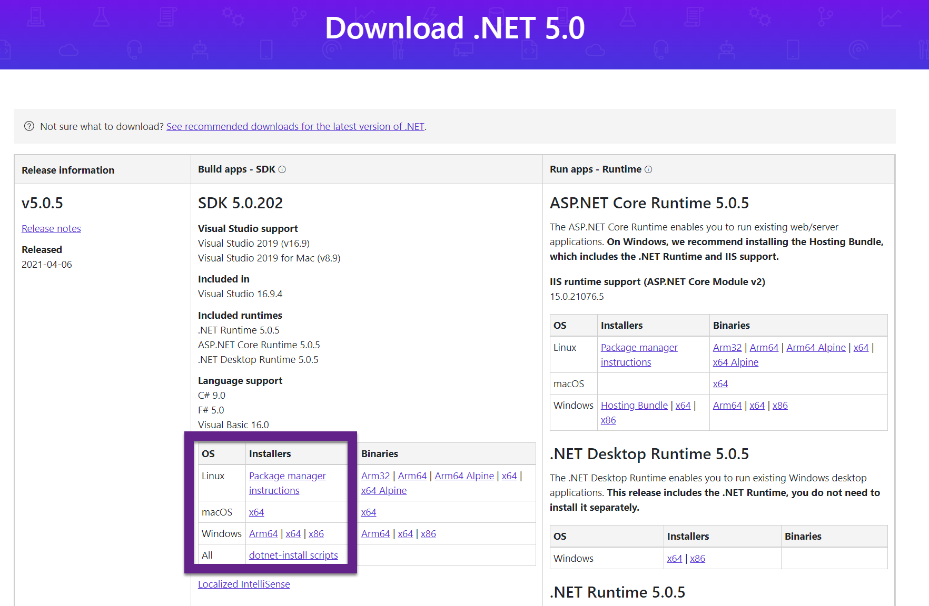
.NET Interactive Notebooks
https://dotnet.microsoft.com/download/dotnet/5.0
Notes:
OBS:SpeakerTopRight

Slide 32
.NET Interactive Notebooks
If you have earlier releases – you MAY need to uninstall and repair - YMMV
https://dotnet.microsoft.com/download/dotnet/5.0
Notes:
OBS:SpeakerTopRight

Slide 33
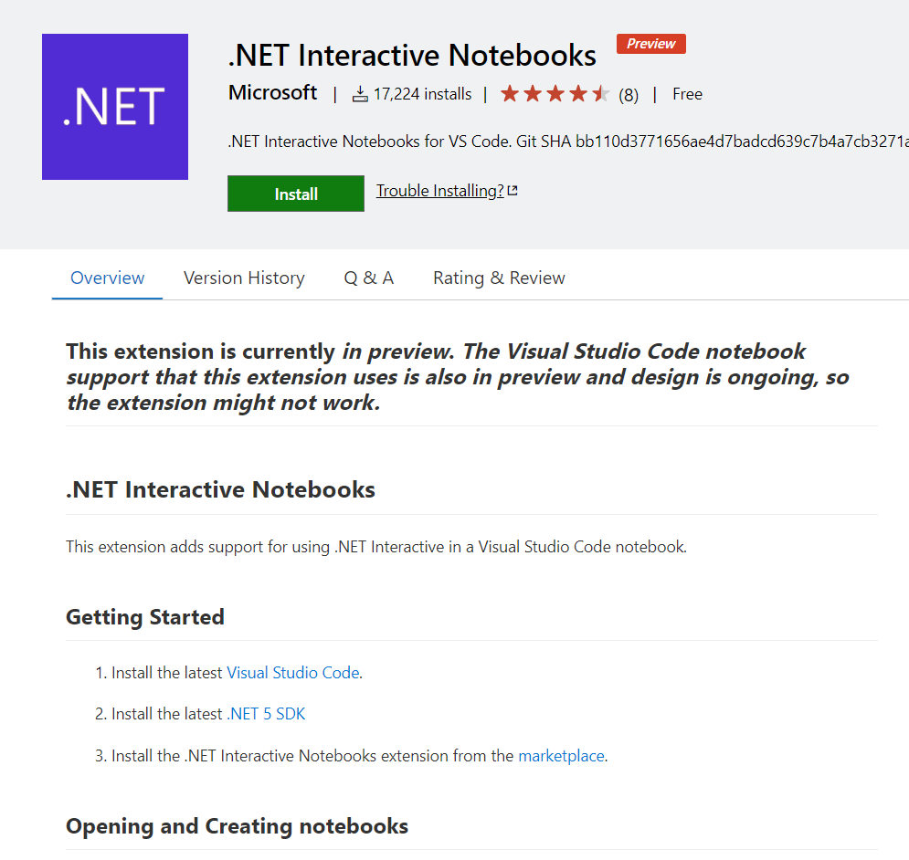
.NET Interactive Notebooks
https://marketplace.visualstudio.com/items?itemName=ms-dotnettools.dotnet-interactive-vscode
Notes:
OBS:SpeakerTopRight

Slide 34
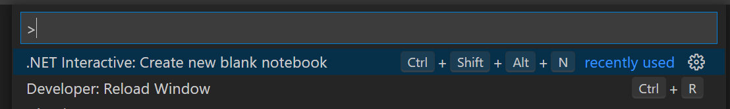
.NET Interactive Notebooks
CTRL + SHIFT + P – Always use this
Notes:
OBS:SpeakerCentreBottom

Slide 35
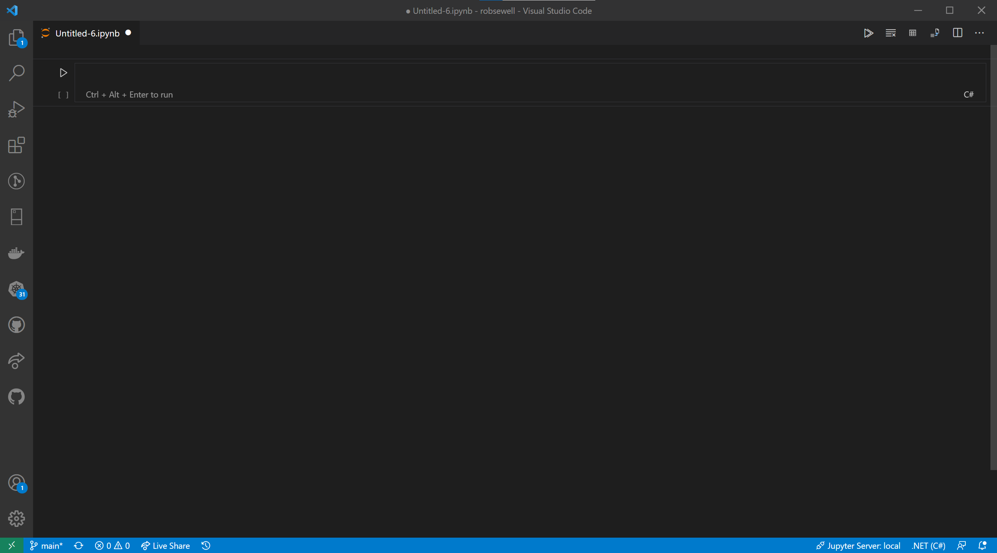
Notes:
OBS:SpeakerCentreBottom

Slide 36
Notes:
OBS:SpeakerCentreBottom

Slide 37
Notes:
OBS:SpeakerCentreBottom

Slide 38
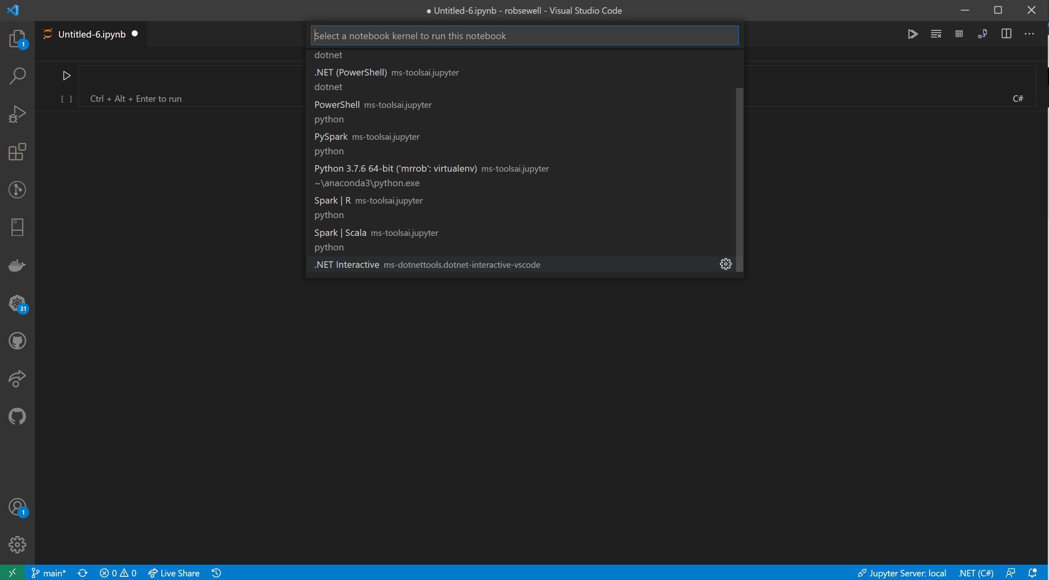
Notes:
OBS:SpeakerCentreBottom

Slide 39
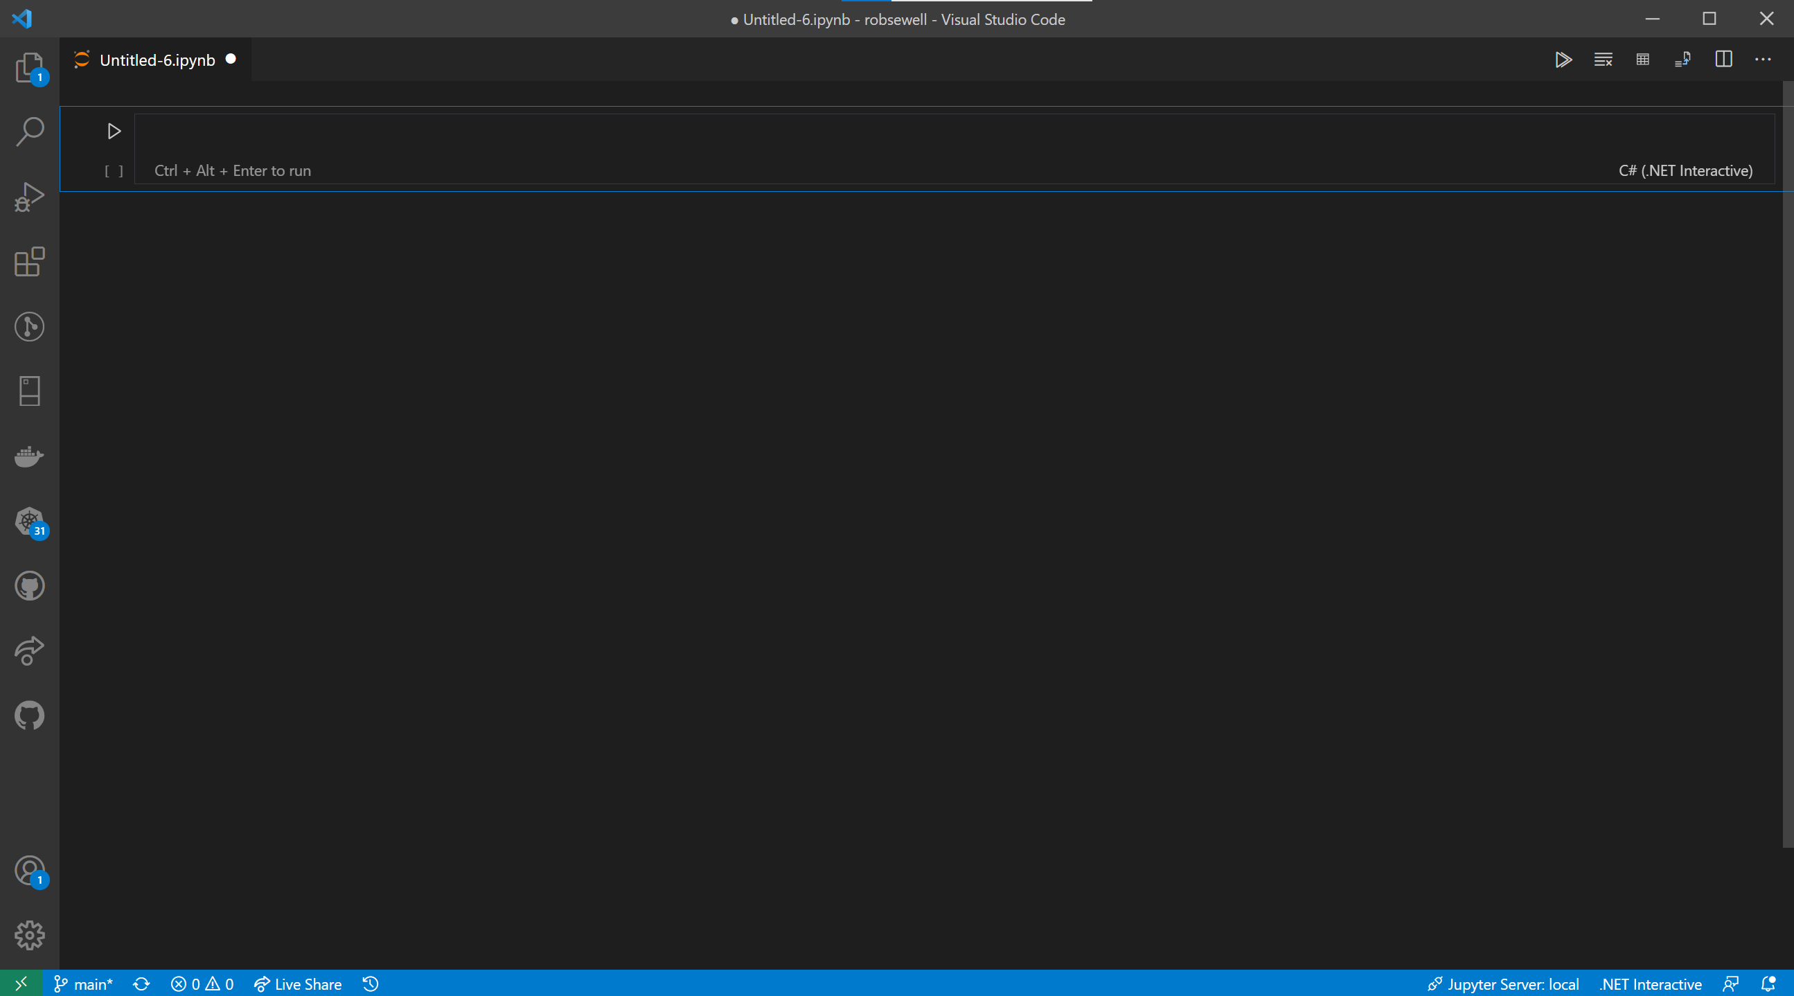

Slide 40
Notes:
OBS:SpeakerCentreBottom

Slide 41
Notes:
OBS:SpeakerCentreBottom

Slide 42
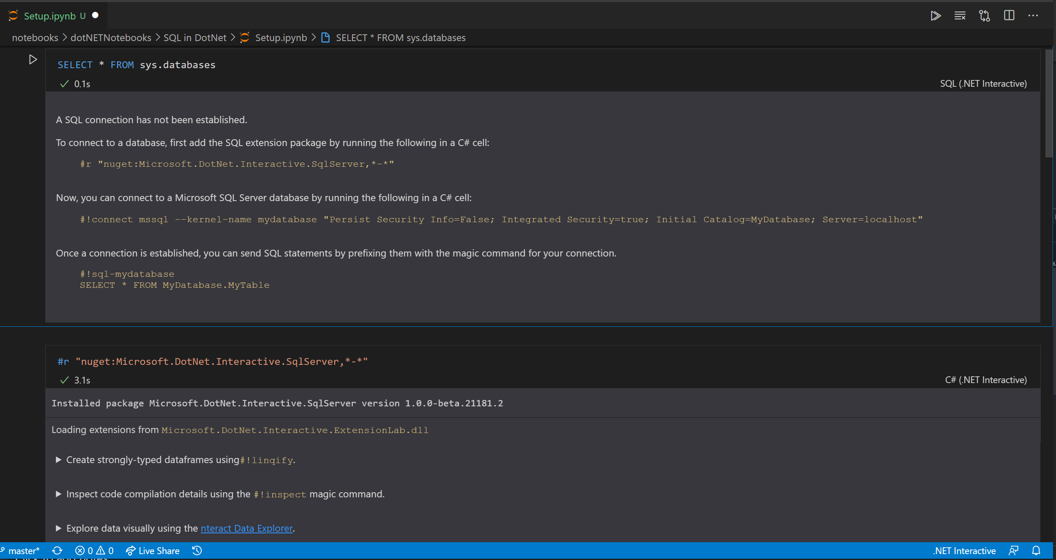

Slide 45
Notes:
OBS:SpeakerCentreBottom

Slide 47
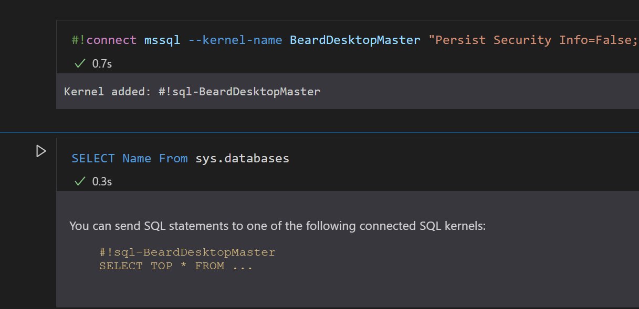
#!connect mssql --kernel-name BeardDesktopMaster "Persist Security Info=False; Integrated Security=true; Initial Catalog=master; Server=localhost"

Slide 48
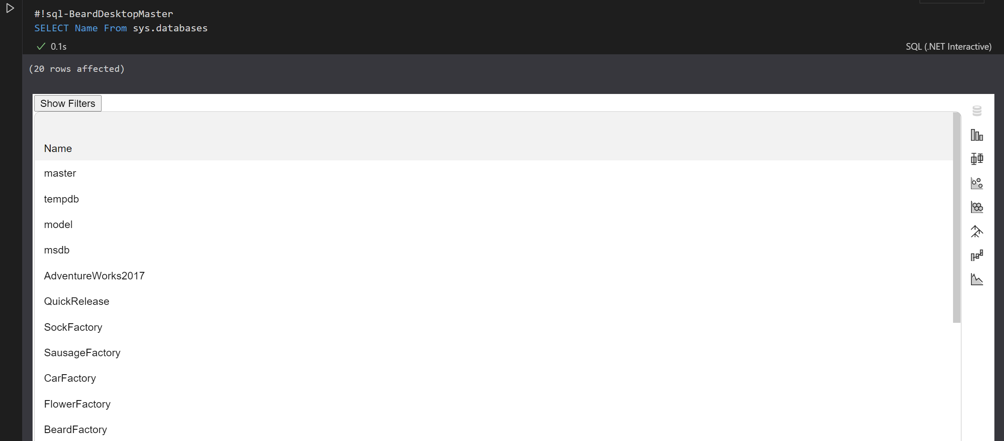
Notes:
OBS:SpeakerCentreBottom

Slide 49
Whatcha gonna do?
Incident Response
Run Books – Common Tasks
Training/ New Starter Introduction
Demos – Clients/team members/boss/ presentations/open source
Notes:
OBS:SpeakerTopRight

Slide 50

Photo by naomi tamar on Unsplash

Slide 51







Incident Response Flow & Ecosystem
System Event / User Reported Incident
Use existing notebooks
Create new notebooks
Add reusable notebook
Rate existing notebooks
Log adhoc notebook in incident system
Update notebook if necessary
Automate
From Julie @MSSQLGirl https://github.com/MsSQLGirl/jubilant-data-wizards
Incident Response System
Investigate & Mitigate
Use Notebook as the incident’s audit trail
Post Mortem
Analyze and enrich Troubleshooting Repo
Troubleshooting Notebook Repo
Notes:
OBS:SpeakerTopRight

Slide 52

https://beard.media/notebooksyoutube Various Beardy Demos about Jupyter Notebooks in Azure Data Studio. Many demos are different even if the presentation is the same.
Time For A DEMO

Slide 53
Wondering how I did this?
Bit of PowerShell
PowerPoint
And StreamLabs Obs
https://beard.media/slobsautomation
Notes:
OBS:SpeakerTopRight

